Slide 1
Lab: Updating Dynamic Data in Place
Made for Professor Lanham A. by Amrit Singh

Slide 2
AGENDA
Accessing the AWS management console
Task 1: Analyzing the lab environment
Task 2: Connecting to the Hadoop main node by using SSH
Task 3: Running Hive interactively
Task 4: Creating tables out of source data by using Hive
Task 5: Joining tables by using Hive
Task 6: Querying the resulting dataset

Slide 3
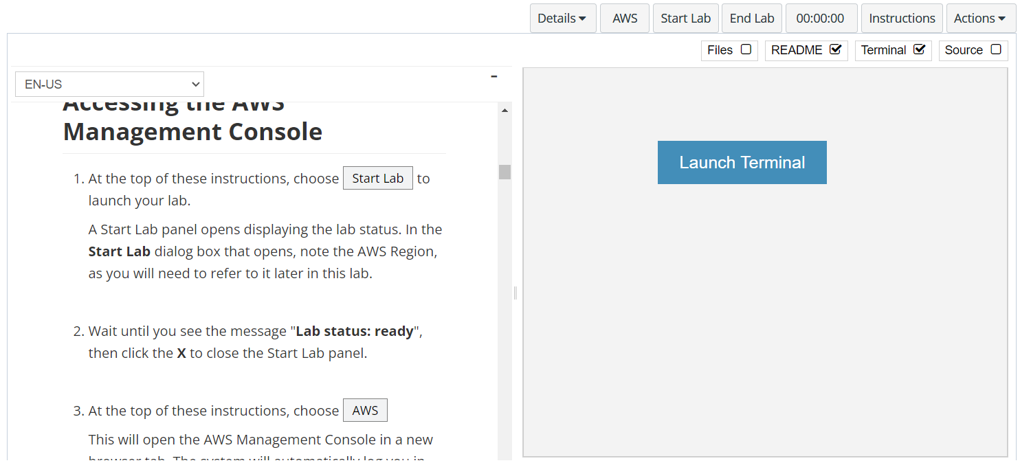
In aws labs click on start lab

Slide 4
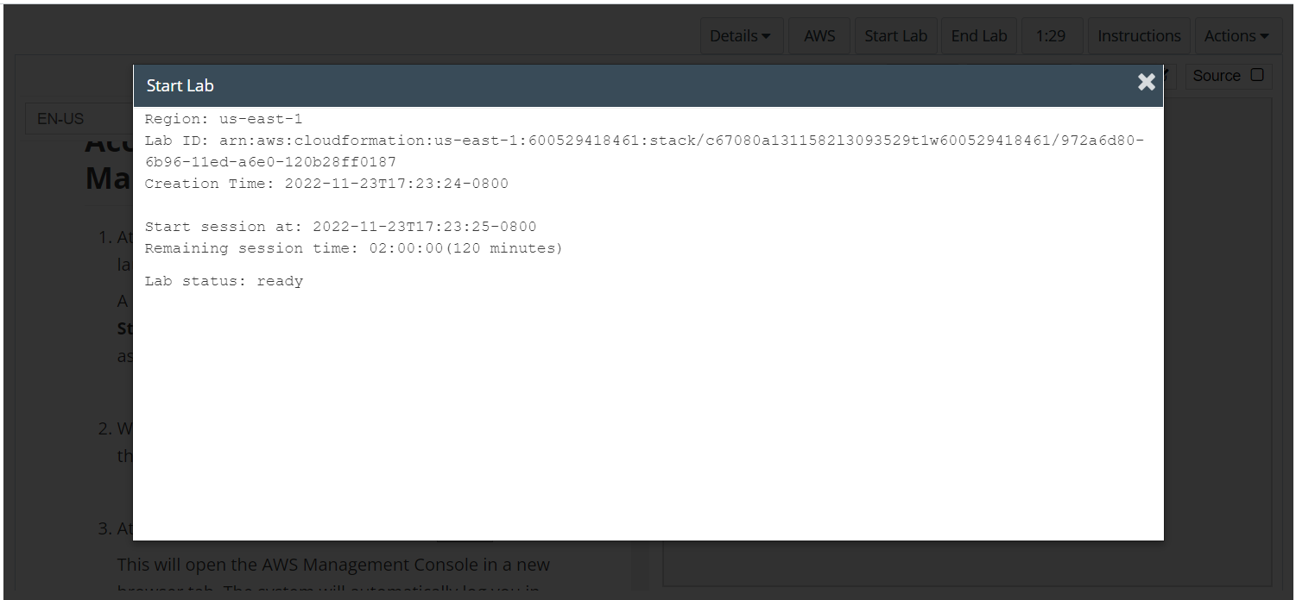
Wait to see lab ready status in the window then press x and click on aws to launch console

Slide 5
Task 1: Analyzing the lab environment

Slide 6
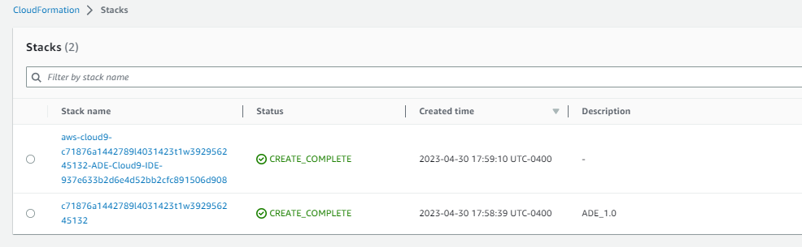
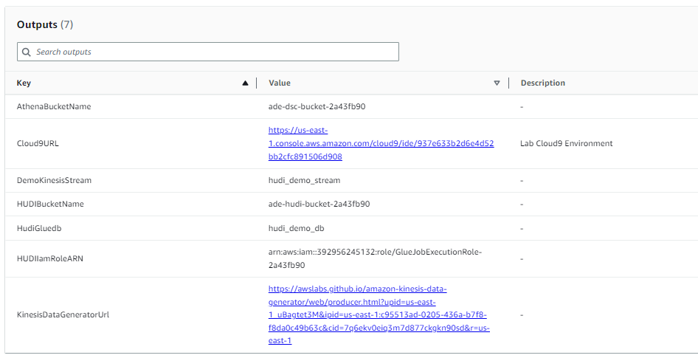
Open the cloudformation console
Retrieve values for resources that were created in the lab environment.
In the search box to the right of Services, search for and choose CloudFormation to open the AWS CloudFormation console.
In the stacks list, choose the link for the stack name where the Description contains ADE.
Choose the Outputs tab.
Copy these values to a text editor to use later in the lab.

Slide 7
Task 2: Subscribing to and activating the Hudi connector

Slide 8
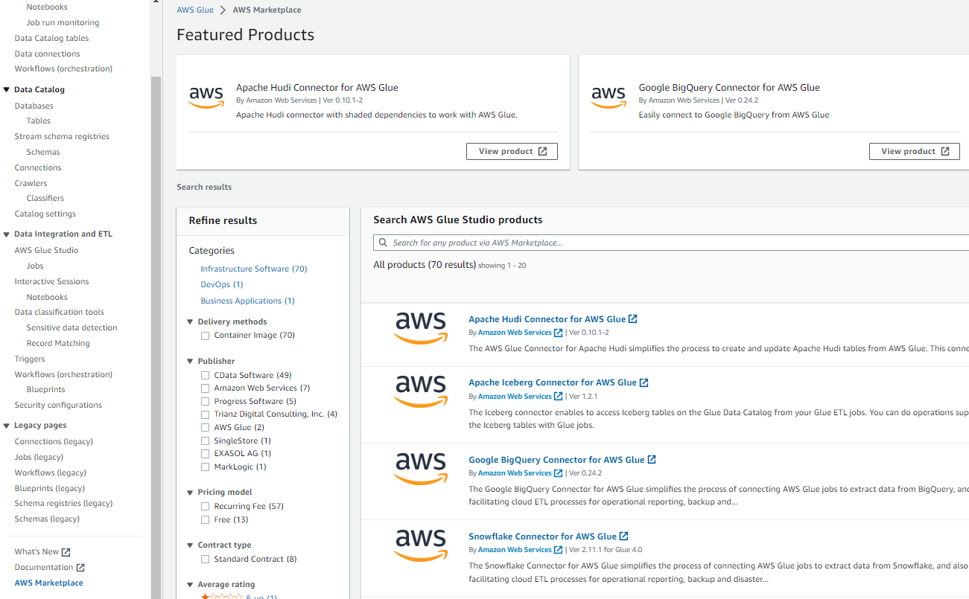
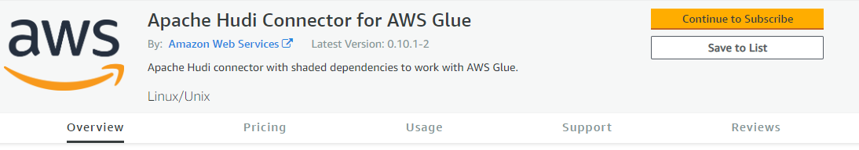
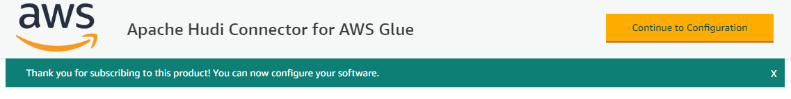
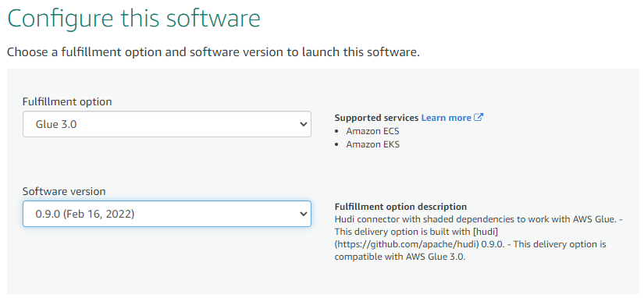
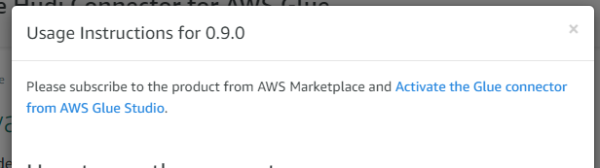
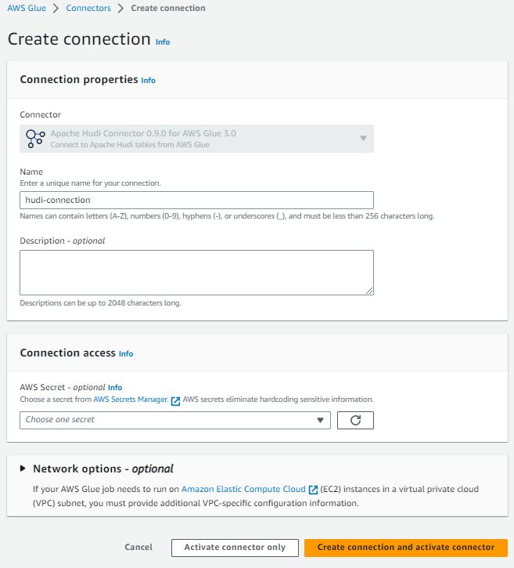
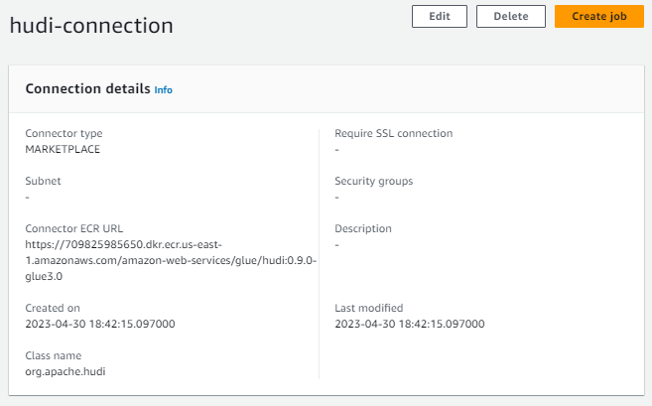
Activiate hudi connector
Create the Hudi connector for AWS Glue.
In the search box to the right of Services, search for and choose AWS Glue Studio.
Open the navigation pane (choose the menu icon ), and then choose Marketplace.
In the Search AWS Glue Studio products section, search for hudi
Choose Apache Hudi Connector for AWS Glue.
Choose Continue to Subscribe.
Choose Accept Terms.
Wait for the Continue to Configuration button to be available.
Choose Continue to Configuration.
For Fulfillment option, choose Glue 3.0.
For Software version, choose 0.9.0 (Feb 17, 2022).
Choose Continue to Launch.
Choose Usage instructions.
Near the top of the dialog box, choose Activate the Glue connector from AWS Glue Studio.
For Name, enter hudi-connection
Choose Create connection and activate connector.
To view the details, in the Connections section, choose the hudi-connection link

Slide 9
Task 3: Configuring job scripts for AWS Glue

Slide 10
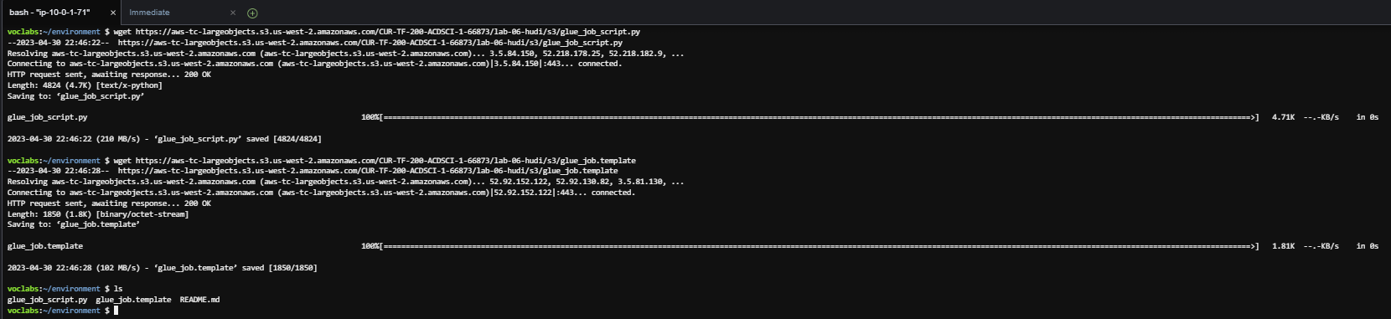

Configure the glue jobs file
Open the AWS Cloud9 terminal and download two files.
From the text file where you recorded outputs from the CloudFormation stack, find the Cloud9URL value. Paste that URL in a new browser tab or window to open the AWS Cloud9 terminal.
To download the files to configure and run the AWS Glue job, run the following commands:
Copy the files to an S3 bucket.
Run the following commands. In both commands, replace <HUDIBucketName> with the bucket name that you recorded from the CloudFormation outputs.
wget https://aws-tc-largeobjects.s3.us-west-2.amazonaws.com/CUR-TF-200-ACDSCI-1-66873/lab-06-hudi/s3/glue_job_script.py
wget https://aws-tc-largeobjects.s3.us-west-2.amazonaws.com/CUR-TF-200-ACDSCI-1-66873/lab-06-hudi/s3/glue_job.template
aws s3 cp glue_job_script.py s3://<HUDIBucketName>/artifacts/
aws s3 cp glue_job.template s3://<HUDIBucketName>/templates/

Slide 11
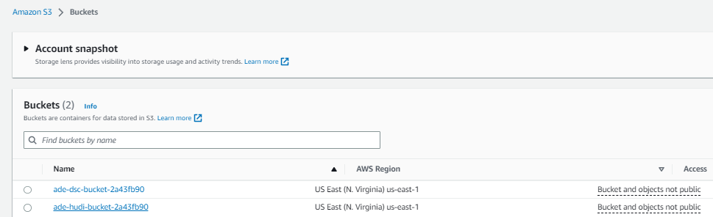
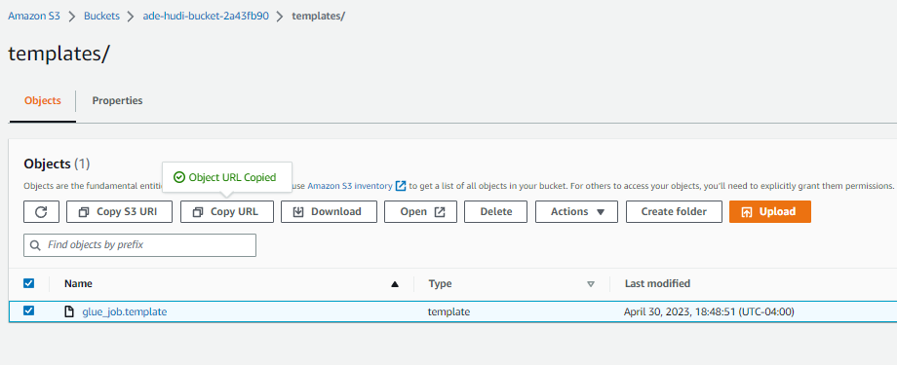
Configure the glue jobs file
Retrieve the URL for the CloudFormation template that you uploaded for the AWS Glue job.
In the search box to the right of Services, search for and choose S3 to open the Amazon S3 console.
Choose the link for the bucket name that contains ade-hudi-bucket.
Choose the templates link.
Select glue_job.template, and then choose Copy URL to copy the URL for the template. Save the URL to your text editor.

Slide 12
Task 4: Configuring and running the AWS Glue job

Slide 13
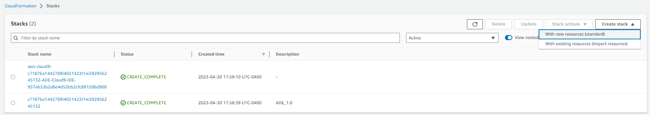
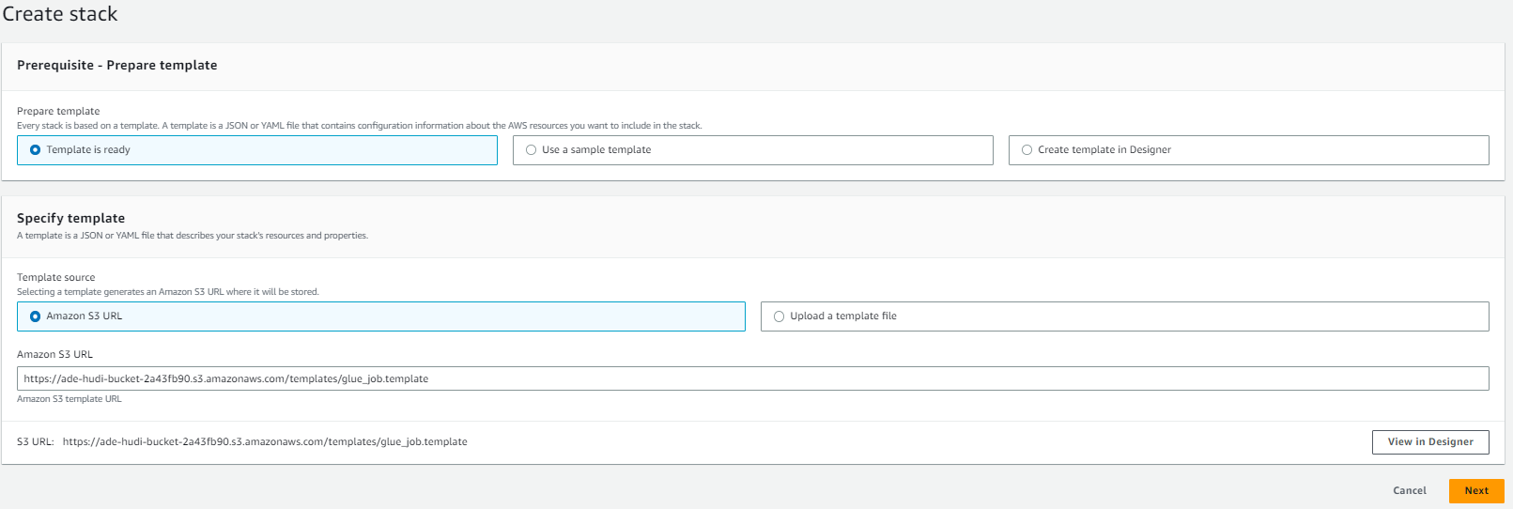
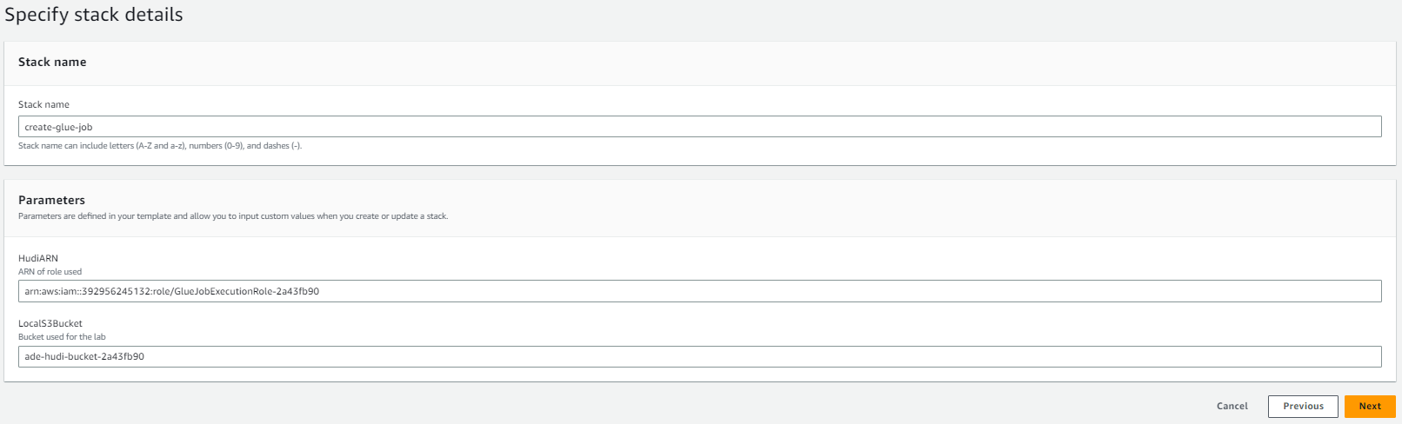
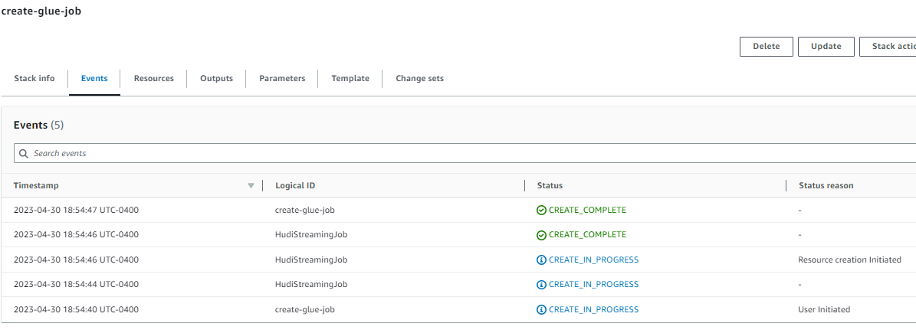
Creating the stack for the glue job
Use Cloudformation to create a stack for the AWS Glue job.
Navigate to the CloudFormation console.
Choose Create stack > With new resources (standard).
For Template source, choose Amazon S3 URL.
For Amazon S3 URL, paste the URL for the CloudFormation template, which you retrieved from Amazon S3 previously.
Choose Next.
For Stack name, enter create-glue-job
For HudiARN, paste the HUDIIamRoleARN value that you recorded from the CloudFormation outputs.
For LocalS3Bucket, paste the HUDIBucketName value that you recorded from the CloudFormation outputs.
Choose Next.
Choose Next again.
Choose Create stack.

Slide 14
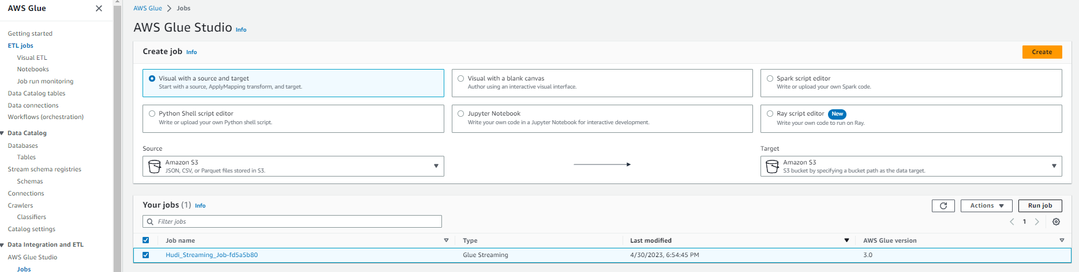
Run the aws glue jobs
Run the AWS Glue job.
In the search box to the right of Services, search for and choose AWS Glue to open the AWS Glue console.
In the navigation pane, under ETL, choose Jobs.
In the Your jobs section, choose the link for the job name that contains Hudi_Streaming_Job.
To start the job, choose Run in the upper-right corner.
To view the status of the job, choose the Runs tab.
Before you continue, make sure that the Run status is Running. You might need to refresh the page.

Slide 15
Task 5: Using the KDG to send data to Kinesis

Slide 16
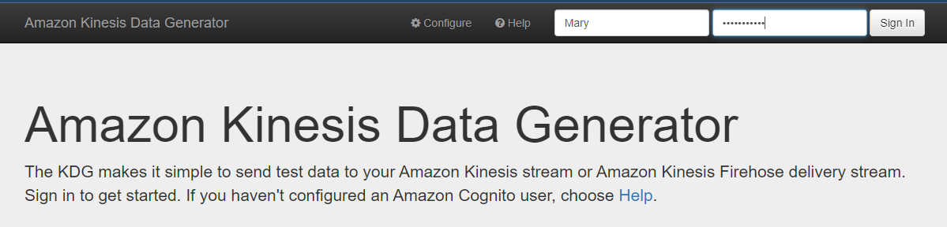
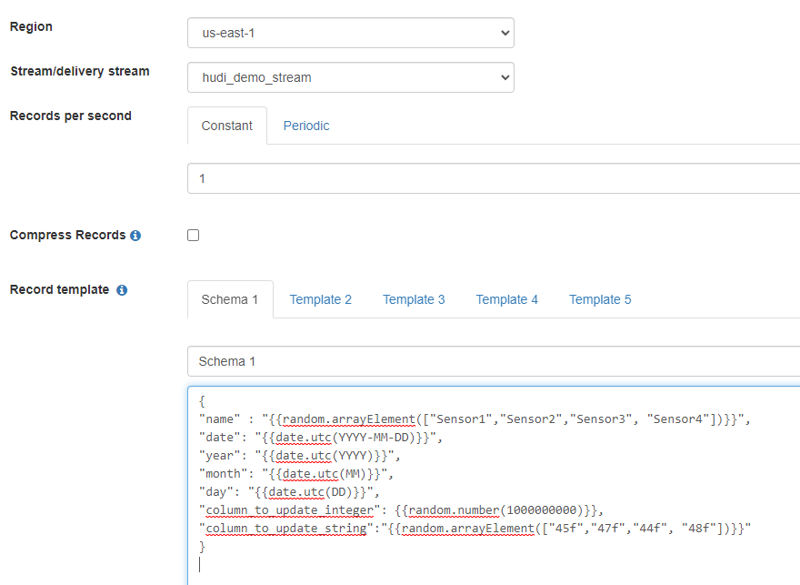
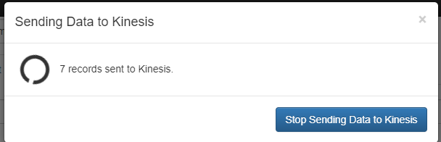
Using KDG for sending data
Access the KDG and start sending data.
From the outputs that you recorded from CloudFormation, find the KinesisDataGeneratorUrl value. Paste that URL in a new browser tab or window to open the KDG tool.
Use the following credentials to sign in to the KDG:
Username:Mary
Password:Welcome1234
In the page that displays after you sign in, configure the following:
Region: Choose us-east-1.
Stream/delivery stream: Choose hudi_demo_stream.
Records per second: Choose Constant and enter 1
For Record template, choose Template 1 and rename it to Schema 1
Copy and paste the following into the Schema 1 code block.
Choose Send data.
{
"name" : "{{random.arrayElement(["Sensor1","Sensor2","Sensor3", "Sensor4"])}}", "date": "{{date.utc(YYYY-MM-DD)}}","year": "{{date.utc(YYYY)}}","month": "{{date.utc(MM)}}","day": "{{date.utc(DD)}}","column_to_update_integer": {{random.number(1000000000)}},"column_to_update_string":"{{random.arrayElement(["45f","47f","44f", "48f"])}}"}

Slide 17
Task 6: Using Athena to inspect the schema and query data

Slide 18
Go to cloud9 and perform the following queries
Inspect the table schema.
Navigate to the AWS Glue console.
In the navigation pane, choose Tables.
Two tables are listed:
hudi_demo_table: This table stores data from the KDG.
hudi_demo_kinesis_stream_table: The AWS Glue job created this table to adapt to NULL values
Choose the link for hudi_demo_table.

Slide 19
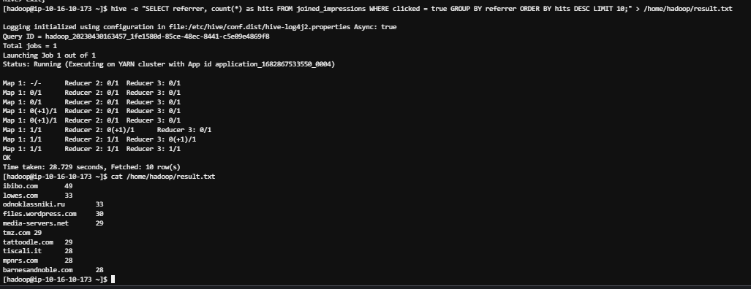
Continue running the sql queries
Continue running SQL queries against the data set.
Next, run the following command:
When the previous command completes, run the following command to read the results:
To exit the SSH session, run the following command:
hive -e "SELECT referrer, count(*) as hits FROM joined_impressions WHERE clicked = true GROUP BY referrer ORDER BY hits DESC LIMIT 10;" > /home/hadoop/result.txt
cat /home/hadoop/result.txt
exit

Slide 20
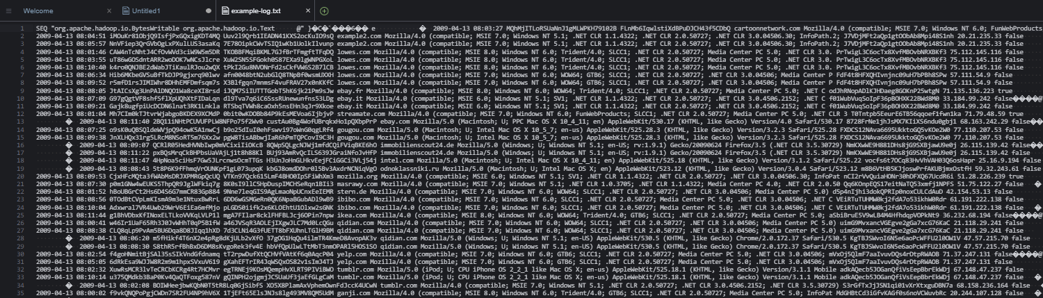
Analyze the log files
Analyze one of the log files that makes up the output from Amazon S3.
To rediscover the name of the bucket that contains the joined_impressions table data, run the following command:
Next, to download the file that contains the data that you have been querying, run the following command (be sure to replace <bucket-name> with the actual hive-output bucket name):
aws s3 ls /
aws s3 cp s3://<bucket-name>/output/tables/joined_impressions/day=2009-04-13/hour=08/000000_0 example-log.txt

Slide 21
Task 7: Reviewing the IAM policy for Amazon Redshift access

Slide 22
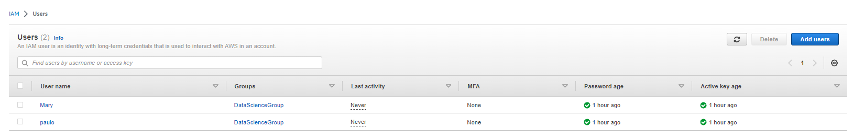
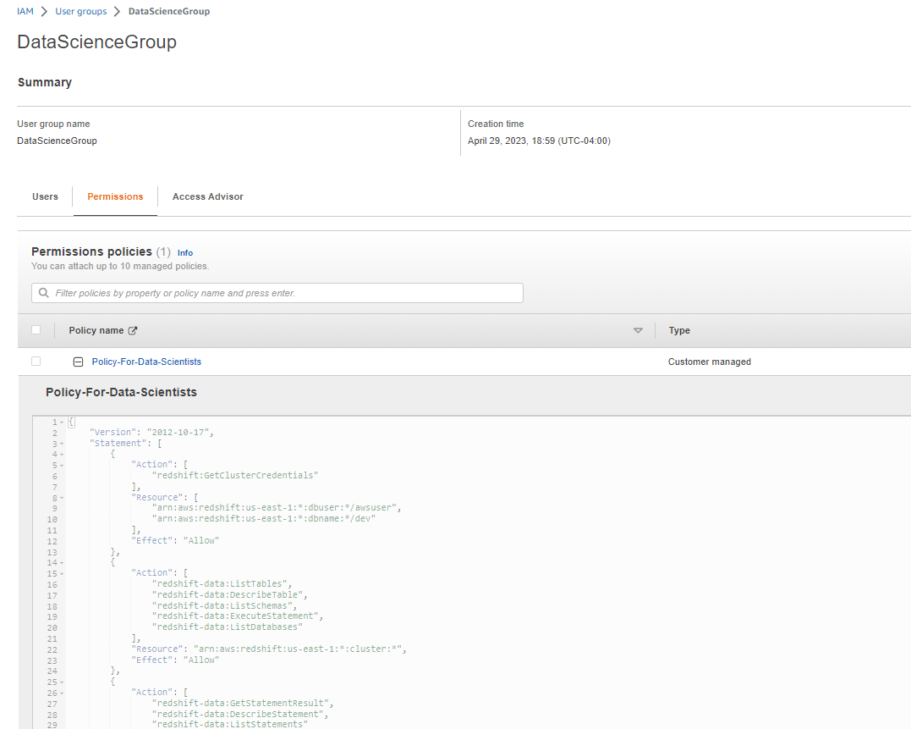
Analyze the iam policy created for you
Review the Policy-For-Data-Scientists IAM policy, which was created for you.
Navigate to the IAM console.
In the navigation pane, choose Users.
Notice the Mary user that is listed. This user is part of the DataScienceGroup IAM group.
Choose the link for the DataScienceGroup IAM group.
Choose the Permissions tab.
The policy that is attached to this group is displayed.
Choose the link for the Policy-For-Data-Scientists policy.

Slide 23
Task 8: Confirming that users can run queries on the Redshift database

Slide 24
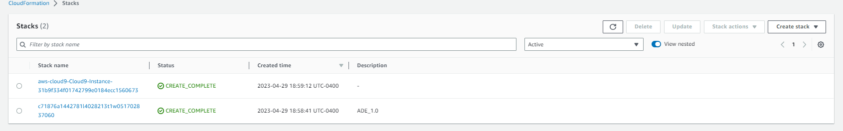
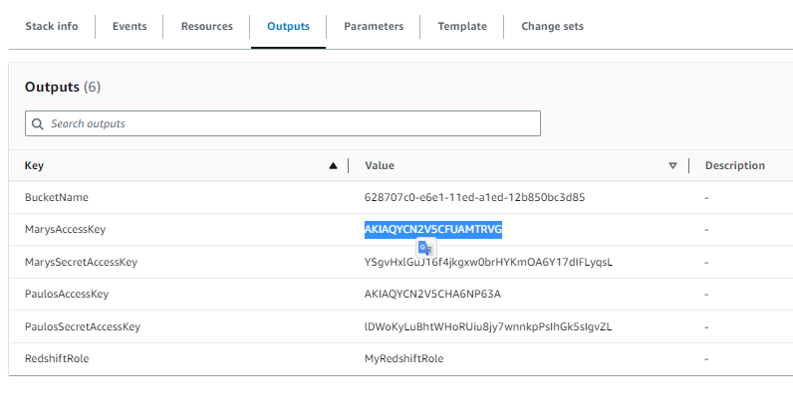

COPY MARY’S ACCESS AND SECRET KEYS AND PASS TO ide
Retrieve the credentials for the Mary IAM user, and store these as bash variables.
In the search box next to Services, search for and choose CloudFormation.
In the navigation pane, choose Stacks.
Choose the link for the stack that created the lab environment. The stack name includes a random string of letters and numbers, and the stack should have the oldest creation time.
On the stack details page, choose the Outputs tab.
Copy the value of MarysAccessKey to your clipboard.
Return to the AWS Cloud9 terminal.
To create a variable for the access key, run the following command. Replace <ACCESS-KEY> with the value from your clipboard.
AK=<ACCESS-KEY>
Return to the CloudFormation console, and copy the value of MarysSecretAccessKey to your clipboard.
Return to the AWS Cloud9 terminal.
To create a variable for the secret access key, run the following command. Replace <SECRET-ACCESS-KEY> with the value from your clipboard.
SAK=<SECRET-ACCESS-KEY>

Slide 25
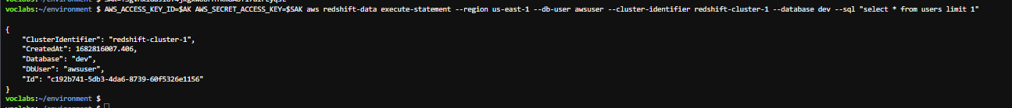
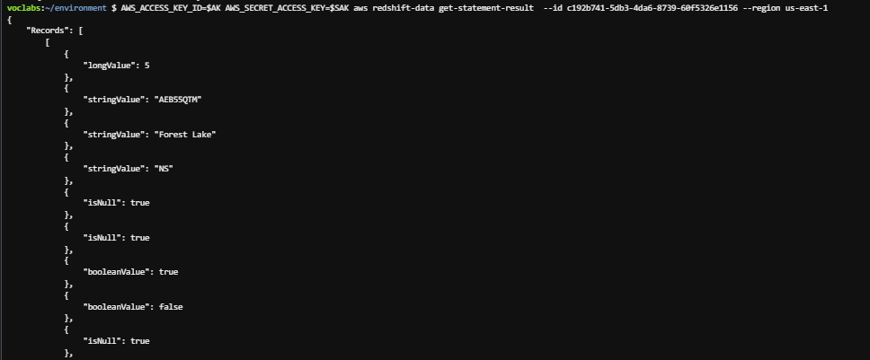
Analyze the iam policy created for you
Use the execute-statement command in the Redshift Data API to query the database.
Run the following command in the AWS Cloud9 terminal.
To retrieve the query results, copy the following command, replace the placeholder with the Id in the response above, then run the command in the terminal:
AWS_ACCESS_KEY_ID=$AK AWS_SECRET_ACCESS_KEY=$SAK aws redshift-data execute-statement --region us-east-1 --db-user awsuser --cluster-identifier redshift-cluster-1 --database dev --sql "select * from users limit 1"
AWS_ACCESS_KEY_ID=$AK AWS_SECRET_ACCESS_KEY=$SAK aws redshift-data get-statement-result --id <QUERY-ID> --region us-east-1

Slide 26
THANK YOU
Amrit Singh

